Slide 1

Dressing in Order: Recurrent Person Image Generation for Pose Transfer, Virtual Try-On and Outfit Editing
Aiyu Cui, Daniel McKee, Svetlana Lazebnik
University of Illinois at Urbana-Champaign
The 4th Workshop on Computer Vision for Fashion, Art, and Design

Slide 2
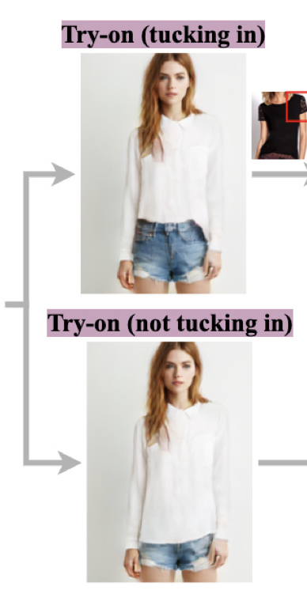
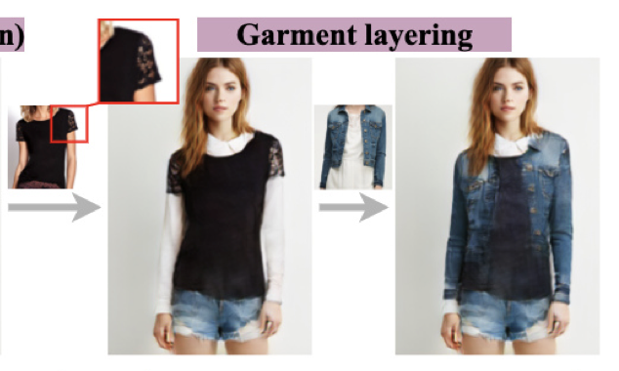
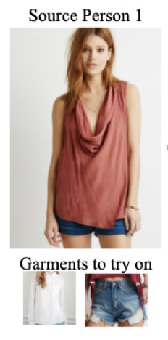
Dressing in Order for Multiple Tasks
Extend virtual try-on to support multiple layouts and multiple layers
Notes:
or

Slide 3
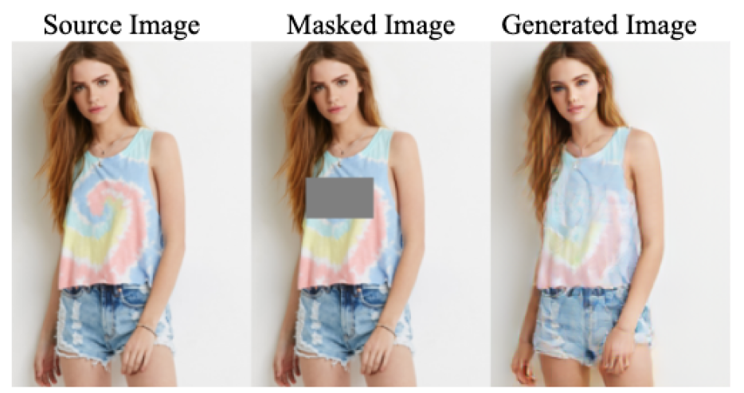
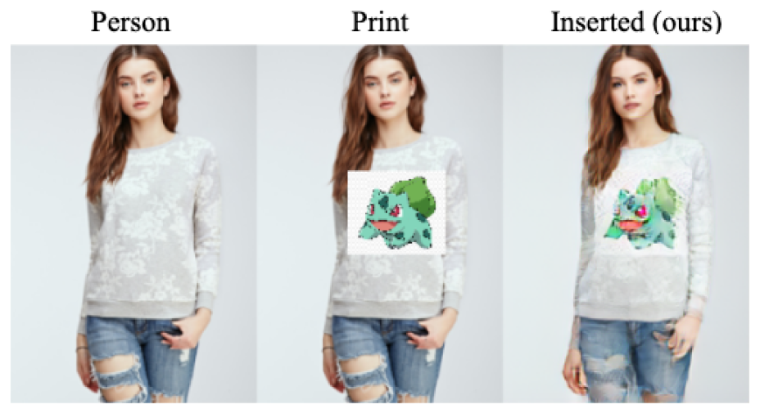
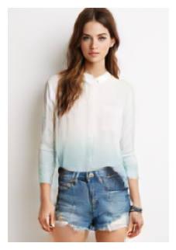
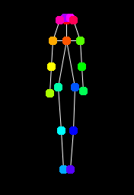
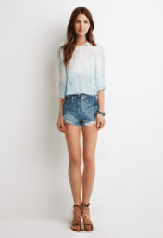
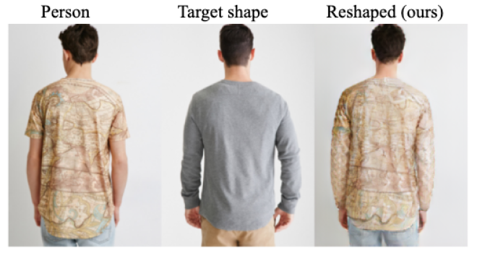
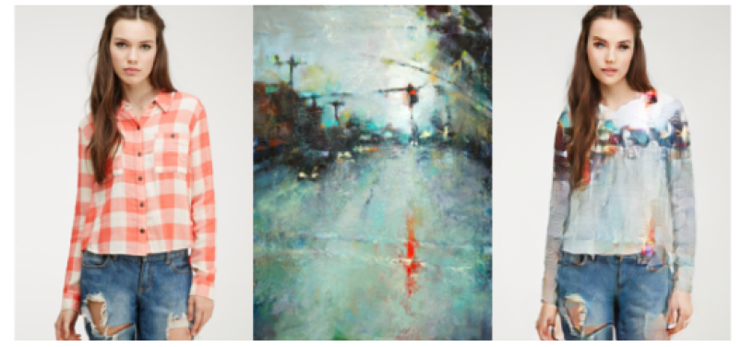
Dressing in Order for Multiple Tasks
Extend virtual try-on to support multiple layouts and multiple layers
Pose Transfer
Outfit Editing
Content Removal
Print Insertion
Pose transfer
Person
Poses
Transferred (ours)
Reshaping
Texture Transfer

Slide 4
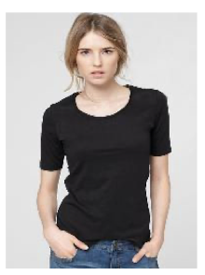
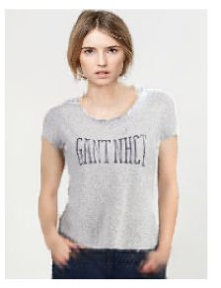

Background: Virtual Try-On
VITON Family: Single Garment Replacement
Predefine a garment category (e.g., top)
(VITON, X. Han et al. 2018)
Limitation: Only work on the specified garment category

Slide 5
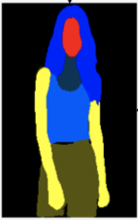
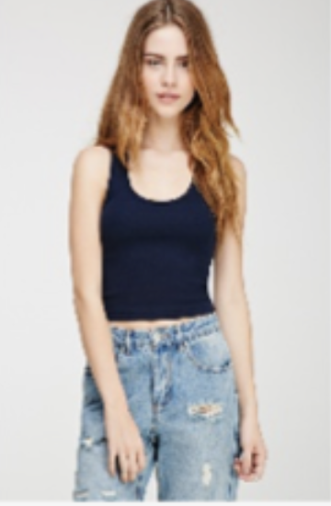
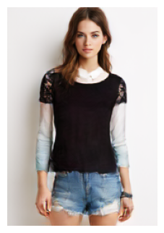
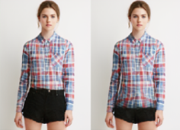
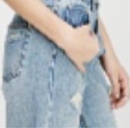
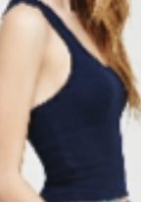

Background: Virtual Try-On
Outfit Try-On: Multi-Garment Replacement
Predefine a set of garment categories (e.g., top, bottom, skirts, etc)
x
x
layering
Multiple layouts
x
Editings
(ADGAN, Y. Men et al. CVPR 2020)

Slide 6
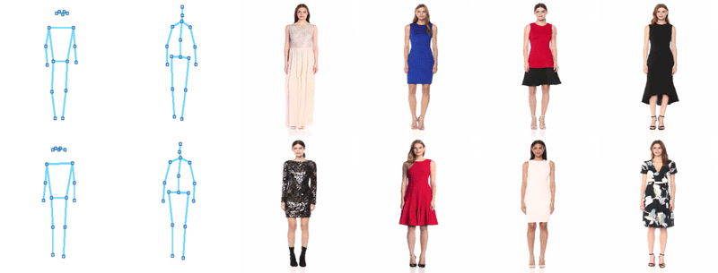
Background: Pose Transfer
Transfer a person from pose A to pose B, while keeping the identity
x
(GFLA, Y. Ren et al. CVPR 2020)
x
Any form of virtual try-on
Editings

Slide 7
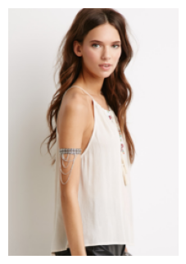
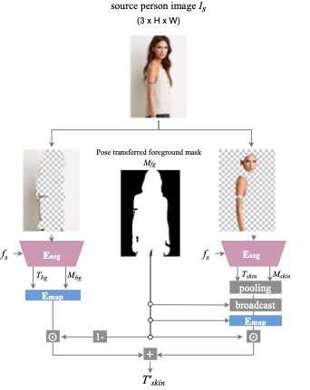
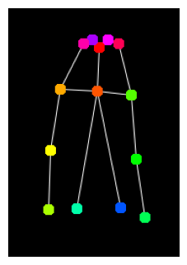
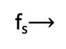
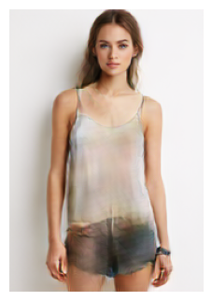
Dressing in Order: A Recurrent Pipeline
- A recurrent mechanism for layering garments
Body
Target Pose
E_{body}
G_{body}
G_{dec}
Notes:
skeleton
skin
garments in order
recurrent mechanism to achieve layering
flow field to adjust garment's position of not aligned
stop generation at any step
change number / category /order
let's see an example
component first (encoder) input -> image of the person to render, firstly encode the body (face, skin) => by xx encoder, (shape/texture zoom in ), generator (+
inject garments one of the
recurent -> as many stages as needed
introduce again
taskehaird as garment -> flow-> segmentations
trasining after pipeline; inpainting is the key to balal (no need to talk about loss)
1. dior
2. 7: mention why skin first
3.

Slide 8
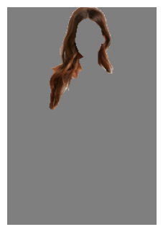
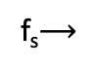
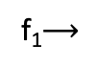
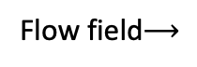
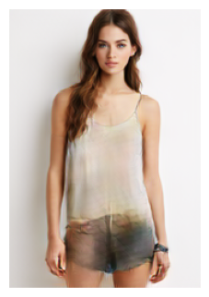
Dressing in Order: A Recurrent Pipeline
- A recurrent mechanism for layering garments
Body
Garment 1
Garment
Target Pose
E_{body}
E_{seg}
G_{body}
G_{gar}
G_{dec}
G_{dec}
Soft Shape Mask
Texture Feature

Slide 9
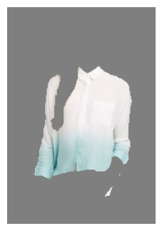
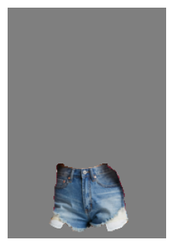
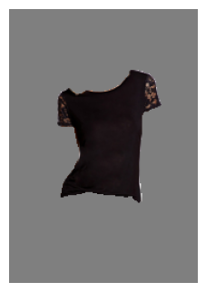
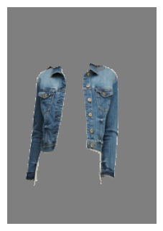
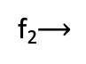
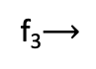
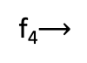
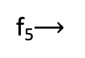
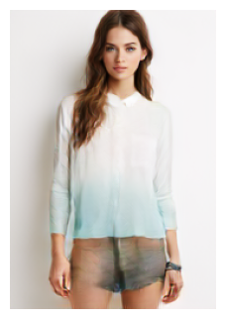
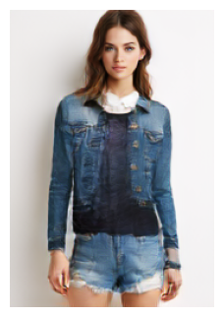
Dressing in Order: A Recurrent Pipeline
- A recurrent mechanism for layering garments
Body
Garment 1
Garment 2
Garment 3
Garment 4
Garment 5
Target Pose
E_{body}
E_{seg}
E_{seg}
E_{seg}
E_{seg}
E_{seg}
G_{body}
G_{gar}
G_{gar}
G_{gar}
G_{gar}
G_{gar}
…..
G_{dec}
G_{dec}
G_{dec}
G_{dec}
G_{dec}
G_{dec}
Notes:
skeleton
skin
garments in order
recurrent mechanism to achieve layering
flow field to adjust garment's position of not aligned
stop generation at any step
change number / category /order
let's see an example
component first (encoder) input -> image of the person to render, firstly encode the body (face, skin) => by xx encoder, (shape/texture zoom in ), generator (+
inject garments one of the
recurent -> as many stages as needed
introduce again
taskehaird as garment -> flow-> segmentations
trasining after pipeline; inpainting is the key to balal (no need to talk about loss)

Slide 10
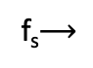
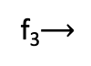
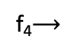
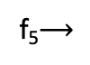
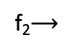
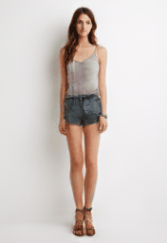
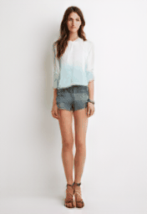
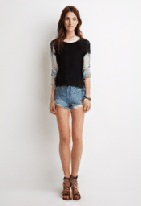
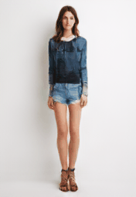
Dressing in Order for Pose Transfer
- Transfer pose by control pose input
Body
Garment 1
Garment 2
Garment 3
Garment 4
Garment 5
Target Pose
E_{body}
E_{seg}
E_{seg}
E_{seg}
E_{seg}
E_{seg}
G_{body}
G_{gar}
G_{gar}
G_{gar}
G_{gar}
G_{gar}
…..
G_{dec}
G_{dec}
G_{dec}
G_{dec}
G_{dec}
G_{dec}

Slide 11
Dressing in Order: A Recurrent Pipeline
- A recurrent mechanism for layering and switching dressing order
Body
Garment 1
Garment 2
Garment 3
Garment 4
Garment 5
Target Pose
E_{body}
E_{seg}
E_{seg}
E_{seg}
E_{seg}
E_{seg}
G_{body}
G_{gar}
G_{gar}
G_{gar}
G_{gar}
G_{gar}
…..
G_{dec}
G_{dec}
G_{dec}
G_{dec}
G_{dec}
G_{dec}
Tucking in

Slide 12
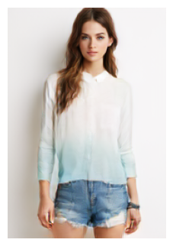
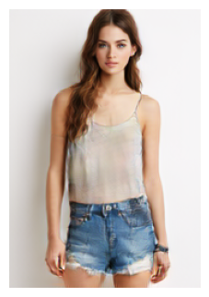
Dressing in Order: A Recurrent Pipeline
- A recurrent mechanism for layering and switching dressing order
Body
Garment 1
Garment 2
Garment 3
Target Pose
E_{body}
E_{seg}
E_{seg}
E_{seg}
G_{body}
G_{gar}
G_{gar}
G_{gar}
Tucking in
Not tucking in
G_{dec}
G_{dec}
G_{dec}
G_{dec}
Not Tucking in

Slide 13




Outfit Editing: Reshaping
- Play with the separated shape/texture encodings
E_{body}
E_{seg}
E_{seg}
Tex.
shape
G_{body}
G_{gar}
….
G_{gar}
G_{gar}
Person
Shape
Reshaped
G_{dec}
Notes:
remove rec part

Slide 14


Outfit Editing: Texture Transfer
- Play with the separated shape/texture encodings
E_{body}
E_{seg}
E_{seg}
Tex.
shape
G_{body}
G_{gar}
….
G_{gar}
G_{gar}
Person
Texture
Transferred
G_{dec}

Slide 15


Outfit Editing: Content Removal
- Play with the separated shape/texture encodings
E_{body}
E_{seg}
E_{seg}
Tex.
shape
G_{body}
G_{gar}
….
G_{gar}
G_{gar}
Person
Masked
Removed
G_{dec}

Slide 16


Outfit Editing: Print Insertion
- Insert a print as an additional “garment”
E_{body}
E_{seg}
E_{seg}
E_{seg}
Tex.
shape
G_{body}
G_{gar}
….
G_{gar}
G_{gar}
G_{gar}
Person
Print
Inserted
G_{dec}
G_{dec}
Notes:
So far, we have talked about dressing in order pipeline can be flexibly applied in a number of editings
Next, we are going to see a more detailed evaluation of the performances

Slide 17










How to Train This Pipeline? – Pose Transfer
Supervised Training on Pose Transfer and Inpainting jointly
Pose Transfer
Target Pose
Source Person
E_{body}
E_{seg}
E_{seg}
E_{seg}
Target Person
GT
G_{body}
G_{gar}
G_{gar}
G_{gar}
G_{dec}
Losses
Notes:
how to train our method:
only train x+y: model can be extended to other tasks

Slide 18









How to Train This Pipeline? - Inpainting
Supervised Training on Pose Transfer and Inpainting jointly
Inpainting
Masked Person
E_{body}
E_{seg}
E_{seg}
E_{seg}
Recovered Person
GT
G_{body}
G_{gar}
G_{gar}
G_{gar}
G_{dec}
Losses

Slide 19

Pose Transfer Performance
User Study
Compared Methods | Preferred others vs. ours
GFLA (CVPR’20) | 47.73% vs. 52.27%
ADGAN (CVPR’20) | 42.52% vs. 57.48%
Person
Pose
GT
ADGAN
GFLA
Ours
(GFLA, Y. Ren et al. CVPR 2020 ADGAN, Y. Men et al. CVPR 2020)

Slide 20


Virtual Try-On Performance
Compared Methods | Preferred others vs. ours
ADGAN (CVPR’20) | 19.36% vs. 80.64%
User Study
Person
Garment
ADGAN
Ours
(ADGAN, Y. Men et al. CVPR 2020)

Slide 21



















Try-On Applications
Layer inside vs. outside
Try-On with different Layouts
Keep layering outside

Slide 22


Editing Applications
Texture Transfer
Reshaping
Input
Texture
Transferred
Input
Shape
Reshaped
Notes:
Next: Additional applications not introduced yet.

Slide 23


Editing Applications
Content Removal
Print Insertion
Input
Masked
Removed
Input
Copy-and-paste
Inserted

Slide 24
Summary
A recurrent mechanism to extend virtual try-on to layering and switching dressing order
A flexible framework to support multiple tasks:
Pose transfer
Virtual try-on
Outfit editing
Thank you ☺
Notes:
no animations

